Slide 1
Intro to ChIP-seq
Vivek Iyer
Slides from Daniel Gaffney

Slide 2
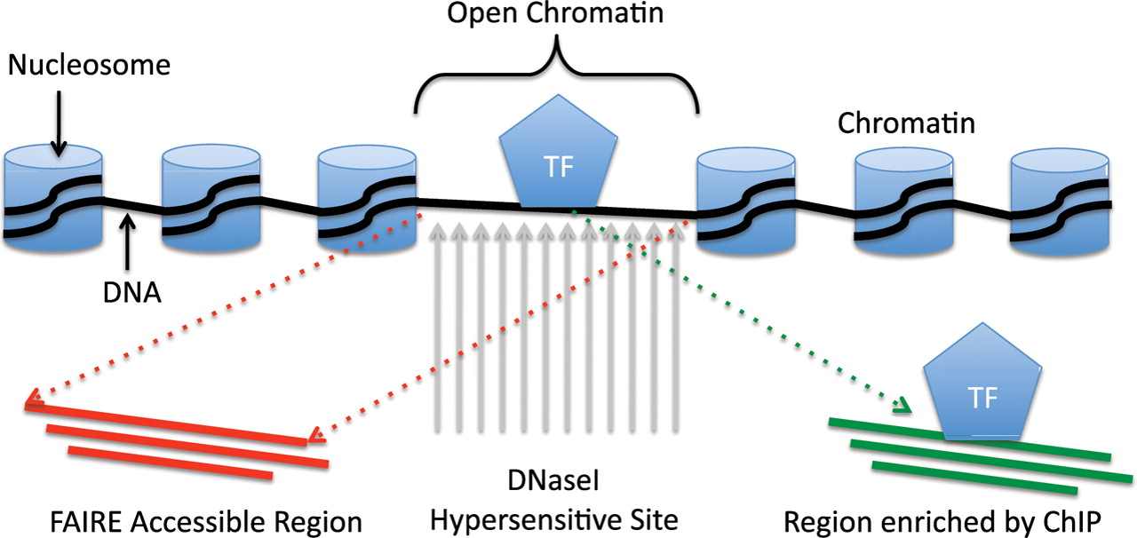
Epigenetics/ChiP in one slide
Regulation of transcription involves interaction of protein and DNA
Notes:
This is an informatician’s view of epigenetics:
How is DNA organized in a cell?
It interacts with proteins, and the regulation of transcription involves interaction of protein and DNA.
Specifically, DNA is condensed by being wrapped around nuclear proteins = HISTONES
NUCLEOSOME:
The repeating DNA/Histone complex (8 proteins) = NUCLEOSOME
CHROMATIN:
Chromatin = complex of DNA and nuclear proteins.
HETEROCHROMATIN
Tightly packed chromatin = heterochromatin = harder for DNA binding proteins to access DNA, not accessible for transcription
EUCHROMATIN
Loosely packed = euchromatin = DNA accessible for transcription
TF:
Transcription factors are proteins that bind to DNA (in euchromatin) to regulate expression via a variety of mechanisms:
stabilize or block binding of RNA Pol
Histone mods:
- Epigenetic mods to histones (methylation, acetylation) to make it bind to DNA more weakly / more strongly, making it more or less accessible to transcription
Euchromatin is enriched by ChIP:
ChIPSeq enriches and sequences open chromatin regions where TFs are binding.
Histone mods are enriched by ChIP:
ChIPSeq enriches and sequences histone mods - indicate gene regulation
IN PASSING:
DNase1 Hypersensitive site.
DNaseI is an endonuclease. It will degrade DNA more readily at open chromatin regions, which also should coincide with where TFs are binding.

Slide 3
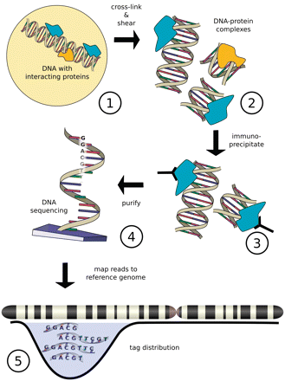
How does ChIP-seq work?
Antibody
Notes:
Protein of interest (POI) is CROSS-LINKED with DNA site it binds to using formaldehyde fixation.
Cells are lysed and DNA is sheared => small (<=1k) double-stranded chunks of DNA, including DNA in a Protein / DNA complex.
An antibody specific to POI is used to bind to protein and then filter out ONLY the bound antibody-protein-DNA-complex. Purify either with attaching AB to solid surface, or magnetic beads.
Note: you can tag the POI and use an antibody against the tag, or use an AB against native protein.
Reverse cross-linking of protein to DNA, convert to single-strand DNA
Sequence the SS DNA.
Align to a genome, Find out where the peaks of the sequences are – these peaks tell you where the protein was bound to DNA

Slide 4
What does ChIP-seq look like?
A statistical procedure (peak calling) is used to call regions of enrichment (peaks)
Can use a control “Input” sample as a background
Peak calling quality varies dramatically by quality of the ChIP-seq
Notes:
The result of sequencing the fragments of DNA which were cross-linked to a protein-of-interest are a set of sequence fragments!
You expect those fragments to be concentrated to where the proteins were binding, and indeed, if you look for the pileups of fragments, you’ll find them co-located with transcripts.
This is the results of many different CHIPSeq runs, showing peaks in the region of the gene Oct4:
There are transcription factors, mediators, cohesins, CTCF: these have relatively narrow peaks compared to the Pol and TBP peaks: they are broad
The other types of binding proteins – mediators, cohesins etc have a variety of shapes
…
Mediator: MED1, MED12: transmit signals from the TF to the Polymerase
Cohesin: responsible for sister chromatid cohesion in cell replication
CTCF: it does _everything_. regulates the 3D structure of chromatin. Can act as a transcriptional activator or repressor.
Pol2, TATABindingProtein. Big signals.

Slide 5
Applications of ChIP-seq
ChIP-seq is one of the most commonly used approaches for identifying gene regulatory regions
Two common types:
Transcription factors
Histone modifications
Notes:
FOCUS on a couple of common applications / protein classes

Slide 6
ChIP-seq for transcription factors
Each of these TFs requires a high quality, ChIP-grade anti-body
Most antibodies (~60%) are not good enough for ChIP-seq
Notes:
START WITH TF
Transcription factors are proteins that bind to DNA (in euchromatin) to regulate expression via a variety of mechanisms:
stabilize or block binding of RNA Pol
… Recruit other proteins into a complex
So you expect narrow peaks around the 5’ TSS, and indeed this is what we’re seeing.
These sorts of peaks are around the TSS. Other proteins are are not necc. clustered around TSS.

Slide 7
EPIGENETIC JARGON CHEAT - SHEET
Regulatory Element | Meaning
Promoter | DNA Sequence (100-1kb), initial secure binding site for: RNA Pol complex Transfacs Adjacent regulated gene, defined relative to TSS. Poised: simultaneous activation/repressive histone mods.
Enhancer/Silencer | DNA Seq (50-1.5kb), bound by transfacs (activator / repressor) Can act on gene up to 1Mb away: DNA folding brings it close to promoter. Enhancer: Bound by activator, which interacts with complex initiating transcription. Silencer: bound by repressor, which interferes with GTF assembly.
Insulator | DNA, 300-2kb, Block enhancers from acting on promoters: positioned between enhancer and promoter, form chromatin-loop domains.
Polycomb-repressed | Polycomb – group proteins actively remodel chromatin to silence genes.
Notes:
But first, a quick review of some epigenetic terminology: this will help with the table that’s about to come…
General Transcription Factor

Slide 8
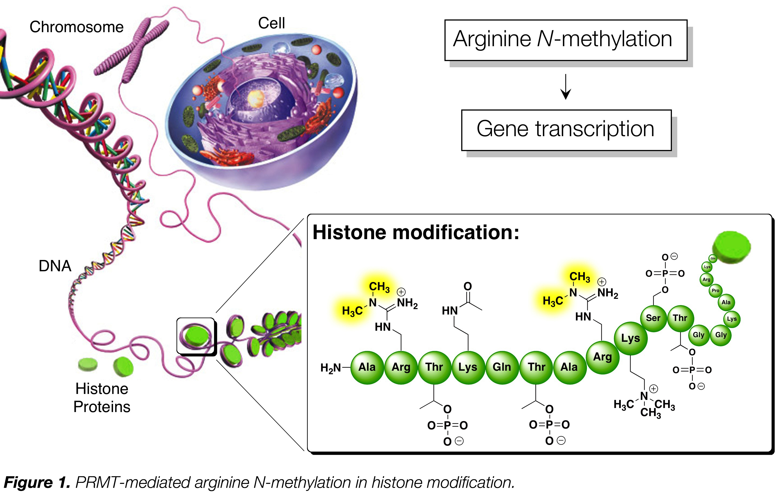
Histone modifications
Antibodies can also be made against histone modification
Notes:
Histone modifications can also be shown by chipseq, and are a contrasting picture:
Recapping; HISTONES: proteins DNA wraps around, forming the nucleosome.
So histone / DNA interaction is critical in determining whether the chromatin is open or closed.
Histone code hypothesis:
Chromatin / DNA interactions are guided by combinations of histone mods.
What is a histone mod? It’s the addition of a single, double or triple methyl group (CH3) to the N terminus of a histone protein residue. Or an acetyl group (CO-CH3)
Which histone protein? There are 4 histone protein families (H1-H4) in the nucleosome. Mods to residues in the H3 and H4 family are the best understood.
Turns out, You can get antibodies against specific modifications, so you can do chipseq (histone-dna complex) to localize on the genome WHICH mods are in effect in particular cell types and states.
Result: There is a catalog of possible mods, and their significance.

Slide 9
Histone mark cheat sheet
Histone mark | Candidate State | Interpretation
H3K9me2,3 | - | Silenced genes
H3K27me3 | Inactive/poised promoter, polycomb repressed | Downregulation of nearby genes
H3K36me3 | Transcriptional transition | Actively transcribed gene bodies.
H4K20me1 | Transcriptional transition | Transcriptional activation
H3K4me1,2,3 | Strong enhancer | Promoter of active genes
H3K27ac | Active promoter/strong enhancer | Active transcription
H3K9ac | Active promoter | Switch from transcription initiation to elongation.
Notes:
So here is my simplistic cheat-sheet of the actual KNOWLEDGE of the transcriptional effect of any particular histone mod.
Note: mods are on H3 or H4 as we noticed
In this case it’s a particular Lysine residue which is being modified
Mod is 1=>3 methyl groups being stuck on (or the acetyl group being stuck on)

Slide 10
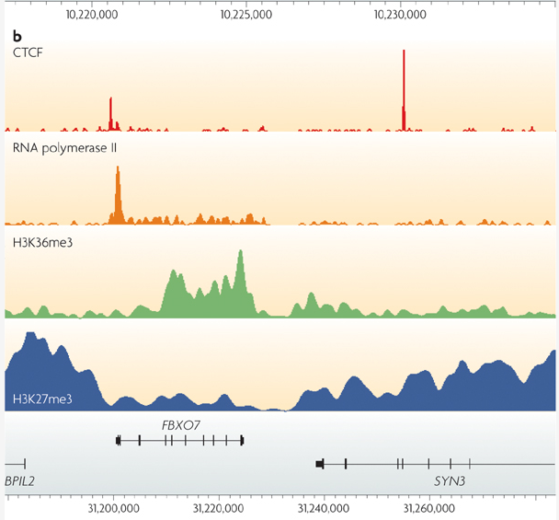
Histone marks
Notes:
Visually: Histone mark / peaks are larger and can coincide with gene bodies

Slide 11
The histone code
Ernst et al 2011
First: create these categories by applying HMM classifying stretches of genome to combined peak data:
9 cell lines x 9 chromatin marks. Apply functional interpretation after categories are created.
Then: go back and ask what fraction of classified regions contain peaks of a given type.
Notes:
Given those terms, I can put up a table like this.
Start by taking 9 cell lines and 9 chipseq experiemnts, clustering the patten of the resulting peaks
The clusters are called regulatory classes.
Then those clusetsr are these coloured rectangles
The Table shows the fraction of peaks from a cluster which lie in any given chipseq expt
So you can see the patterns making up a cluster.
The moral of the table is that these classes of histone mods have distinct patttens.
The actual function of the groups was bolted on afterwards by just knowing what each of these histone mods did.

Slide 12
ChIP-seq experimental considerations
Antibody quality must be high: 60% of antibodies not high enough quality
Numbers of cells: 2-3M recommended, more for TFs (5-10M)
Crosslinking time: ~10 mins
Shearing fragment checked – next slide
Notes:
So now I turn to desired experimental conditions:
These are simply relayed to me by a biologist (Dan Gaffney) so I will relay them to you!
Make sure your antibodies are of high quality!
That you have enough cells! And that you cross-link DNA and protein for long enough!
And that you shear to get the right fragment size:

Slide 13
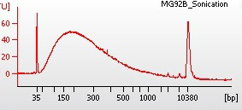
Shearing
FRAGMENTS: Aim for fragments in 150-400bp range
Efficiency varies by cell type
Optimise by varying number of shearing cycles
Run input samples on Bioanalyser to check efficiency
READS: Longer reads better than shorter (uniqueness)
Paired End reads better than single end reads (uniqueness on mapping)
Notes:
You can check the fragment size with bioanalyser: you want 150-400bp fragments
Read alignment:
Effect of read length on SE/PE on alignment rates:
Longer SE read aligns more unique better than short SE read (increase from 50=>75, say)
Paired more unqiue than single, IF read length is constant. BUT if you make the PE longer, THEN align rate drops off: drop in quality at 3’ end.
Longer reads: better coverage over repetetive regions.
PE design: better coverage over repetetive regions.
Peak numbers:
PE more than SE (approx. 10^5 peaks) – because more reads!
Read length: no impact on numbers of peaks.
PE => better IDR

Slide 14
ChIP-seq technical issues
Signal / noise: Does my antibody work?
Library complexity: Did I have enough starting material?
Notes:
Turn to two checks of CHIPSeq signal:
S/N
And
Library complexity

Slide 15
Signal / noise
Noise (background)
Signal
Notes:
Signal is sequenced DNA which has bound to the protein you want.
NOISE is DNA that you don’t want also being included in the sequencing.
This may be because you pull down protein you weren’t expecting which is also cross-linked.
So it’s an indicaition of whether your antibody is specific enough.

Slide 16
Signal / noise
Signal
High signal/noise
Noise
Noise
True binding site
Signal
Low signal/noise
Noise
Noise
True binding site
Notes:
The b/g is an indication of S/N – put up two examples, one of low b/g and one of high b/g

Slide 17
Signal-to-noise
High background
Notes:
And in real life, this shows many different tracks: you can see the high-bg (noise) tracks – they’re the ones with distracting grass between the peaks

Slide 18
Measuring S/N via FRIP
Fragments In Peaks
# Fragments found in peaks / Total # fragments
>1%
Notes:
One way of checking how good your peaks are relative to the b/g is to check Fragments in Peaks, relative to total # of all fragments:
This is an ENCODE guideline. this should be >1%
Generally, FRIP increases linearly with numbers of called peaks. FRIP works when there are ~thousands – 10’s thousands of called sites.
Empirically:
You can use FRIP to compare performance of the SAME antibody in different conditions / cell lines.

Slide 19
Library complexity
Problem: Not enough starting material
Not enough cells
Antibody efficiency
More PCR required
Notes:
Turn to library complexity.
This becomes a problem when there are not enough cells or not enough DNA pulled down – maybe antibody wasn’t efficient enough.
As a result you have to do more PCR to have enough material to sequence

Slide 20
Library complexity
Signal
High complexity
Noise
Noise
True binding site
Signal
Low complexity
PCR duplicates
Noise
Noise
True binding site
Notes:
Conceptually this looks as follows

Slide 21
Library complexity
Decreasing complexity
Notes:
And this is a real-world set of signals arranged from high to low complexity: you can see that as the complexity decreases, the peaks are (sort of) still there, but the signal becomes patchy / grain, and the noise gets amplified

Slide 22
Measuring complexity – Nonredundant fraction
NRF = # unique fragments positions / total # fragments
Encode goal: NRF >0.8
Notes:
General Goal from ENCODE: obtain > 10m reads per replicate.
Given that, ENCODE Defines a Complexity metric:
fraction of nonredundant mapped reads = NRF = #number of unique positions in genome / total number of reads.
Want NRF >= 0.8 for 10 million uniquely mapped reads.
See here:
https://www.ncbi.nlm.nih.gov/pmc/articles/PMC3431496/
“For each ChIP-seq point-source library, ENCODE’s goal is to obtain ≥10 million uniquely mapping reads per replicate experiment for mammalian genomes, with a target NRF (nonredundancy fraction) ≥0.8 for 10 million reads.”

Slide 23
ChIP-seq technical issues
Signal / noise: Does my antibody work?
Fragment of Reads in Peaks > 1%
Library complexity: Did I have enough starting material?
Non-redundant fraction > 0.8
Notes:
Turn to two checks of CHIPSeq signal:
S/N
And
Library complexity

Slide 24
Basic analysis of ChIP-seq
Read alignment
Visualisation
Peak calling
“Bump finding”
Peak annotation (mapping peaks to genes etc)
Motif analysis
Differential binding
Case / control
Naïve / stimulated
Notes:
We turn from QC measures of the experiment to a quick overview of how analysis goes.

Slide 25
Basic analysis of ChIP-seq
Read alignment
Visualisation
Peak calling
“Bump finding”
Peak annotation (mapping peaks to genes etc)
Motif analysis
Differential binding
Case / control
Naïve / stimulated
Notes:
We turn from QC measures of the experiment to a quick overview of how analysis goes.

Slide 26
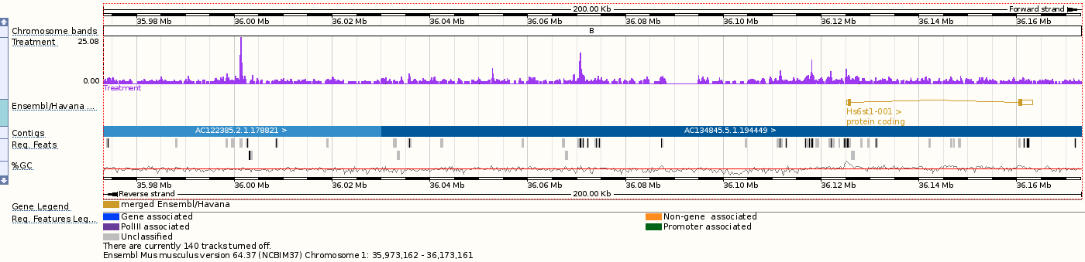
Visualisation in a genome browser
Convert mapped reads to “signal” – e.g. read depth at each bp or in windows
BAM files to e.g. wig, bedgraph
IGV, ensembl, UCSC
Notes:
Read alignment we have already covered – will be done with aligners you’re familiar with, taking care to be run with right parameters
Once you’ve got the reads they need to be visualized. You really should do this.

Slide 27
Peak calling
Sliding window
-log10(pval)
P-value threshold (FDR corrected)
peak
Observed counts
Expected counts
Poisson test: p-value – prob(observing frag count at least as extreme under null)
Notes:
After vis you can do peak calling, which goes conceptually like this:
Count reads from treatment and control in a sliding window, gives observed and expected counts.

Slide 28
Peak calling challenges
What’s expected?
Treatment sample (with antibody)
Input / control sample (no antibody)
Replicates
Yes! (min 2, more = better)
Peak sizes
These are variable: small for TFs, large for some Histone mods, and for Pol2 etc.
Notes:
The INPUT to a peak caller is:
Trreatment bam file
Control bam file
Replicates
BEAR IN MIND that Peak sizes will vary with the protein of interest

Slide 29
Park J, Nature Reviews Genetics, 2009
Notes:
What are the outputs?
These are fold-changes from a MACs run, and p-values.
Notice that the size of the peaks are different from sample to sample:
Transfacs are sharp,
BUT POL2 is low and spread out
H3K36m3 – actively transcribed: medium size broad peaks: along over gene body
H3K27m3 – Polycomb repressor, again showing large peaks on and around gene body.

Slide 30
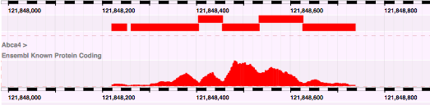
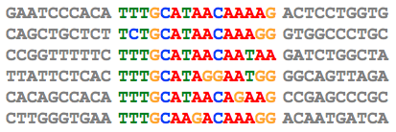
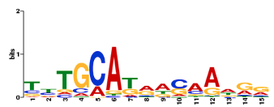
Motif analysisr
EXTRACT SEQ FROM SUMMITS
Align sequences from multiple peaks
CONSENSUS LOGO
Letter Height: Relative Frequency
Stack Height = 2 – Shannon entropy*
*sum_i(p_i log p_i) – how smeared out probs are
More smeared out => lower stack height
Discover motifs
Notes:
Sometimes can identify binding sites with sequence pattern or motif
First: extract SUMMIT from the called peak – as the peak itself could be quite broad
Then look for repeated short sequences in this subset of summits:
do an ALIGNMENT of all seqs against each other
Then make a sequence logo:
Relative freqs of the letters are represented by their relative sizes
Height of stack => how _unsmeared_ the probabilities are between the four bases.
Height = 2 – Shannon Entropy.
SE calculator: https://planetcalc.com/2476/
Notice that SE(0.25, 0.25, 0.25, 0.25) = 2 , so stack heigh = 2-2 – 0
SE(0.99, 0.01) = 0.08, so stack height = 2 – 0.08 = 2

